Slide 1
Capstone Project: Drift Trike
Max Gundrum

Slide 2
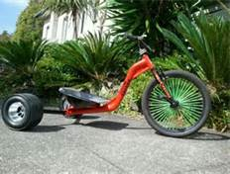
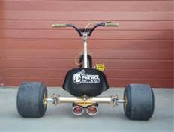
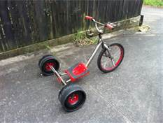
Popular ideas

Slide 3
Video of Drift Trikes
Trike Video
Drift Trikes - Student Documentary Film
Motorized Drift Trike Battles

Slide 4
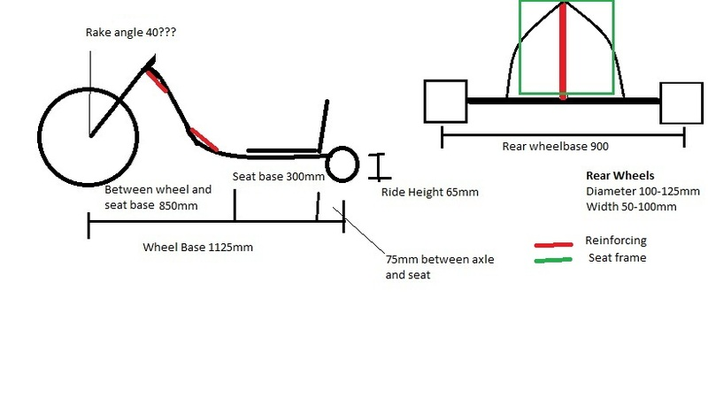
Basic Dimensions
Video on Trike design
Basic design found on the internet:

Slide 5
TurboCAD Blueprint

Slide 6
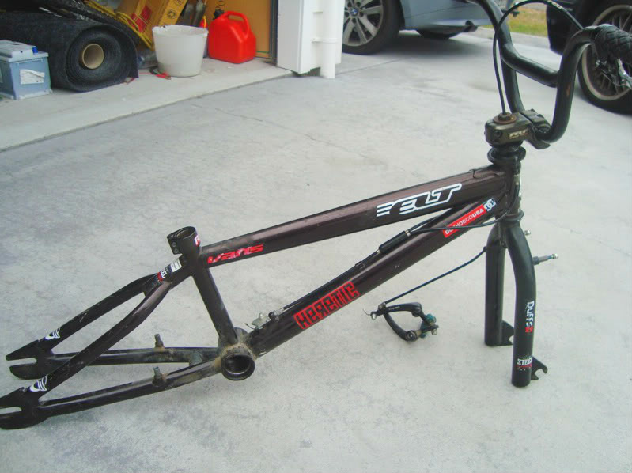
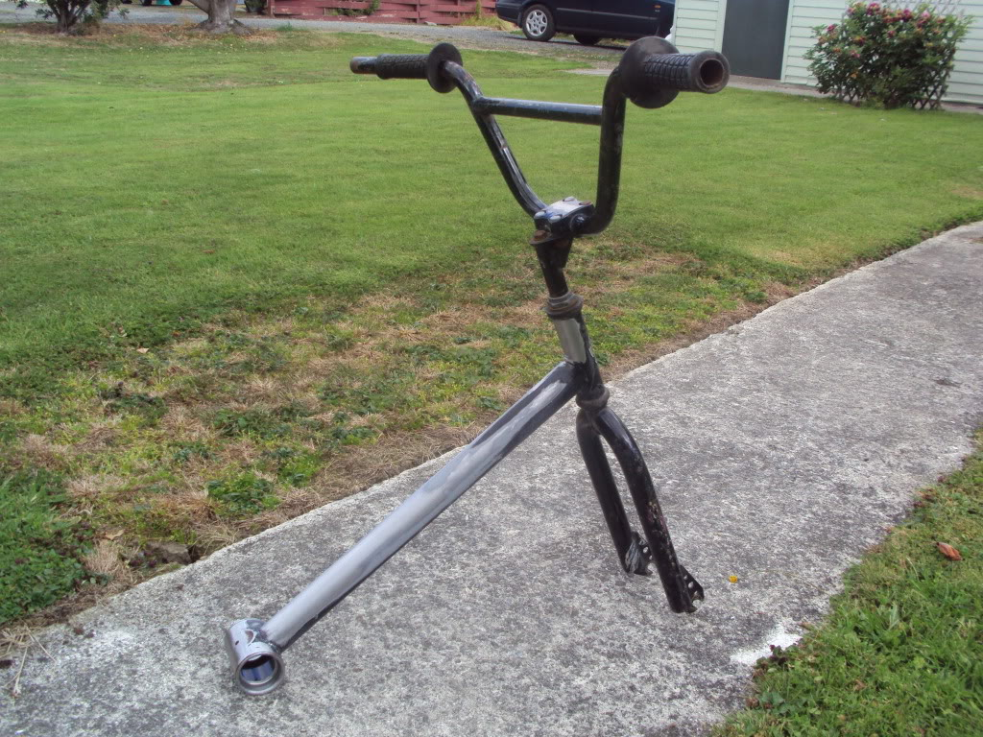
Prep for Building
Example of bike used
Example after bike is cut down

Slide 7
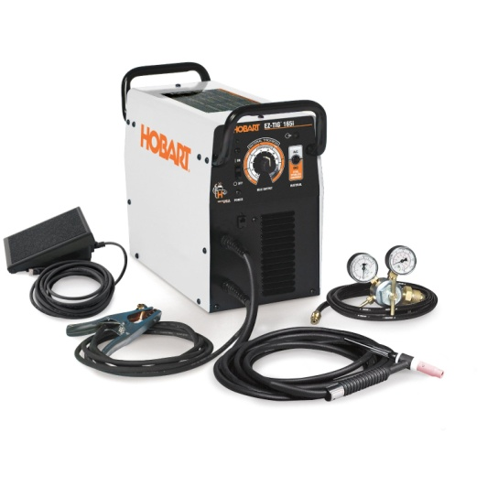
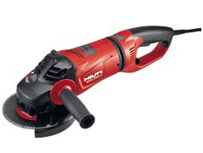
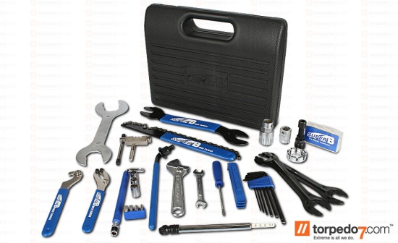
Buliding Of Trike
Tools needed

Slide 8
Work Journal (Starts 4/30/2013)
Work Journal (Starts 4/30/2013)
Day 1: Research of designs and ideas of drift trike
Day 2: Found designs and plans online
Day 3: Watched videos to see popular designs
Day 4: Looked for a bike to use for the project
Day 5: Looked for pricing of parts and materials needed
Day 6: Found basic dimensions and basic welding techniques
Day 7: Started on TurboCAD blueprint
Day 8: working on blueprint
Day 9: Finished blueprint
Day 10: Start prep for cutting bike frame/ getting tools needed
Day 11: Start Building (5/20/2013)
Day 12: started cutting bike frame
Day 13: Welder was not working properly
Day 14: Went and found approximate cost for all materials
Day 15:**FOUND THAT THE WELDER NEEDED REPAIR
*Plans once welder is fixed/replaced
2-4 hours of fabricating and welding metal
2-3 hours of fixing and flaws/ solving problems
1-2 hours of final assembly
~1 hour of final testing, make sure all adjustments are made
1-2 hours of prep for paint and painting
FINISH PROJECT WITHIN 10 DAYS

